Slide 1





DEXTA
DEXmedetomidine Trial of Adjunct Treatment with Morphine
IMP
WPD 5.8_Site Initiation Visit Slide Set Template_V4.0_09-Oct-2025

Slide 2

Purpose of the training
Who are these slides for?
This condensed slide deck provides essential Good Clinical Practice (GCP) guidance for bedside staff who will be preparing, administering and disposing of the DEXTA IMP. It is your responsibility to ensure participant safety, trial integrity and compliance with regulatory and protocol requirements.
You are not required to review the whole SIV slides. Instead, please review these slides and the DEXTA IMP manual. Please ensure you are signed off on the training and delegation log before commencing any DEXTA IMP activity.
These set of slides will cover the following:
  GCP principles
  Basic Trial Information
  IMP Background, Preparation & Administration
WPD 5.8_Site Initiation Visit Slide Set Template_V4.0_09-Oct-2025

Slide 3

GCP principles
WPD 5.8_Site Initiation Visit Slide Set Template_V4.0_09-Oct-2025

Slide 4
GCP Principles
Participant safety
The rights, safety, and well-being of DEXTA participants take precedence over all other considerations.
Discuss any safety concerns with the site DEXTA PI, a member of the local research team, or the DEXTA team at the NCTU as soon as possible.
Ensure that any death or Serious Adverse Event (SAE) of a DEXTA participant is reported to your local research team and the local PI as soon as possible. The investigator will ensure that the SAE is submitted within 24 hours of becoming aware of the event
The trial is not collecting expected SAEs (if in doubt discuss with the site PI) these are:
  Known complications of prematurity, dexmedetomidine or morphine
  Events listed as trial outcomes.
WPD 5.8_Site Initiation Visit Slide Set Template_V4.0_09-Oct-2025

Slide 5
GCP Principles
Participant safety: SAEs
An SAE is = any untoward medical occurrence or effect that:
Results in death
Is life threatening
Requires hospitalisation or prolongation of existing hospitalisation
Results in persistent or significant disability or incapacity
Is a congenital anomaly/birth defect
Or is otherwise considered medically significant by the Investigator
Comments: The term severe is often used to describe the intensity (severity) of a specific event. This is not the same as serious, which is based on participants/event outcome or action criteria.
WPD 5.8_Site Initiation Visit Slide Set Template_V4.0_09-Oct-2025

Slide 6
GCP Principles
Follow the approved protocol
The DEXTA IMP should be prepared and administered exactly as specified in these slides and the IMP manual, according to the DEXTA protocol.
The IMP doses should be given according to the prescription.
Any deviations from the DEXTA protocol or GCP requirements should be reported as a protocol deviation to the DEXTA team.
WPD 5.8_Site Initiation Visit Slide Set Template_V4.0_09-Oct-2025

Slide 7
GCP Principles
Accurate documentation
Please record administered doses of the IMP using your sites drug chart.
Any unused ampoules should be returned to pharmacy. The pharmacy team will then document the disposal of unused ampoules in the DEXTA accountability log.
WPD 5.8_Site Initiation Visit Slide Set Template_V4.0_09-Oct-2025

Slide 8
Trial information
WPD 5.8_Site Initiation Visit Slide Set Template_V4.0_09-Oct-2025

Slide 9
Trial background
Why we are doing the trial
Pain management in ventilated preterm babies is often not well managed or well researched.
Morphine and fentanyl are the drugs most commonly used to manage pain in ventilated newborns but they may:
  not always relieve pain effectively
  slow breathing and feeding, and delay coming off the ventilator
  affect long-term brain development
Dexmedetomidine (dexmed) is a newer medicine already used in adults and children and it may:
  Provide effective pain relief with fewer side effects compared to opiates
  Reduce the amount of morphine babies need
WPD 5.8_Site Initiation Visit Slide Set Template_V4.0_09-Oct-2025

Slide 10
Trial details
Trial groups
The trial is split into three arms:
High dose dexmed (0.5mcg/kg/hr)
+ morphine
Low dose dexmed (0.25mcg/kg/hr)
+ morphine
Placebo
+ morphine
WPD 5.8_Site Initiation Visit Slide Set Template_V4.0_09-Oct-2025
OR
OR

Slide 11
IMP
WPD 5.8_Site Initiation Visit Slide Set Template_V4.0_09-Oct-2025

Slide 12
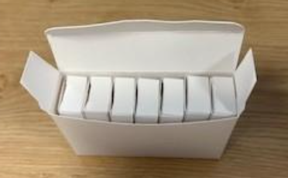
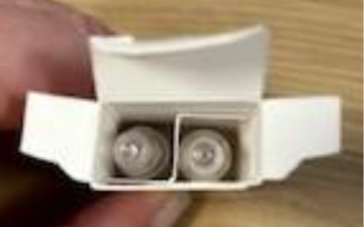
IMP Pack Information
Dexmed
The IMP will be supplied in blinded ampoule pairs with identical packaging.
The ampoules will be 2ml glass ampoules
Each kit contains 7 pairs of ampoules, only 5 will be needed for the infusion
There are 2 spares ampoules to allow for spillage / breakage
Please read the DEXTA IMP manual as part of your IMP and safety training
WPD 5.8_Site Initiation Visit Slide Set Template_V4.0_09-Oct-2025

Slide 13
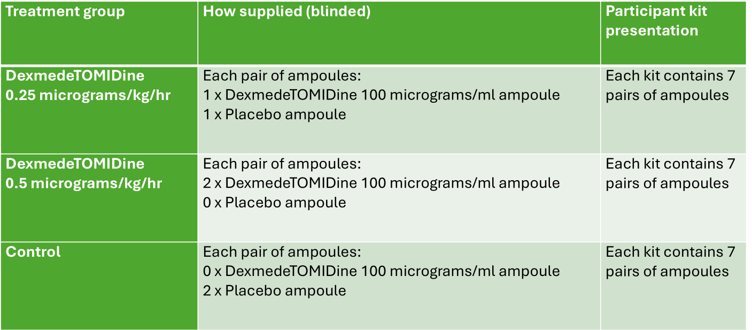
IMP Pack Configuration
Ampoule pairs
Below are the ampoule configurations for each treatment group.
WPD 5.8_Site Initiation Visit Slide Set Template_V4.0_09-Oct-2025

Slide 14
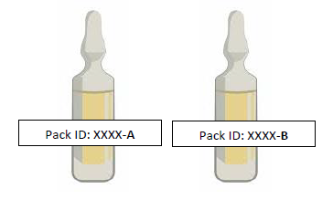
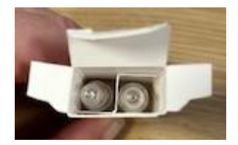
IMP Preparation
Preparation
The pack ID will be provided as soon as randomisation is complete. The pack ID will ensure that blinding is maintained.
Please double check the pack ID on the IMP pack prior to preparation
Use the ampoule pair (A + B) according to the baby’s weight band
Dilute with 5% Glucose or 0.9% sodium chloride
Use immediately after preparation (IV syringe should be changed every 24h)
WPD 5.8_Site Initiation Visit Slide Set Template_V4.0_09-Oct-2025

Slide 15
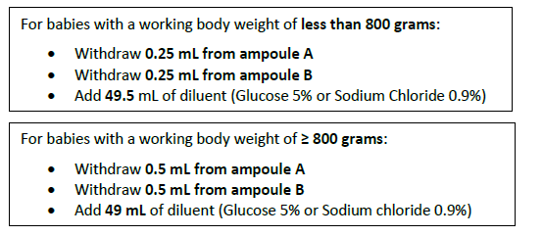
IMP Dilution
Dilution differences
Using aseptic technique, prepare a 50mL infusion syringe according to the baby’s working body weight as follows:
WPD 5.8_Site Initiation Visit Slide Set Template_V4.0_09-Oct-2025

Slide 16
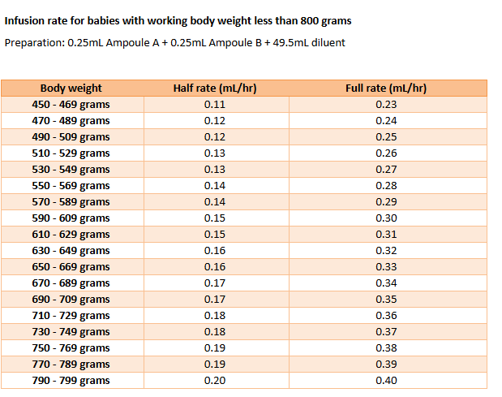
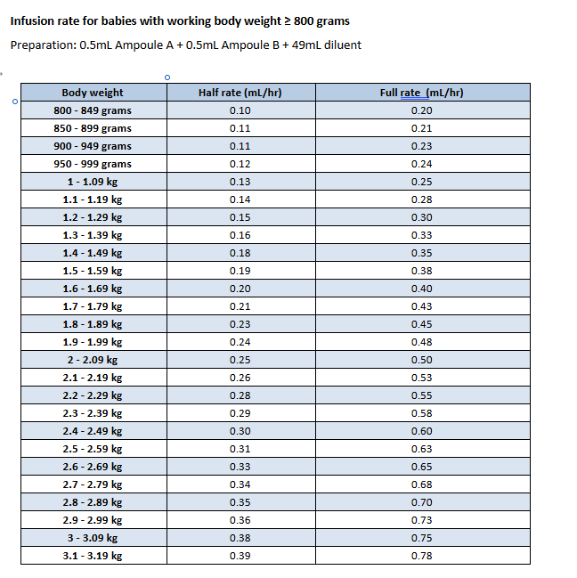
IMP Infusion Rate Chart
WPD 5.8_Site Initiation Visit Slide Set Template_V4.0_09-Oct-2025

Slide 17
IMP Administration
Administration
Begin the infusion when the baby is at least 168 hours old and as close to randomisation as possible.
The infusion can begin at any time during the day. This will count as day 1.
Infuse at half the target rate for the first 24 hours then follow the titration guide
Follow titration guide for pain and haemodynamic stability (this is provided in the IMP manual)
WPD 5.8_Site Initiation Visit Slide Set Template_V4.0_09-Oct-2025

Slide 18
IMP Y site compatibility
Y site compatibility
Compatible with: adrenaline, atracurium, caffeine citrate, calcium gluconate, morphine, etc.
Not compatible with: amphotericin B, diazepam, ketamine
Separate infusion preferred for TPN, fat emulsion, sodium bicarbonate
Full compatibility list is available in the appendix of the IMP manual
WPD 5.8_Site Initiation Visit Slide Set Template_V4.0_09-Oct-2025

Slide 19
IMP Dose Modification
Dose modification and infusion guide
A flowchart to guide IMP and morphine rate titration is provided in the IMP manual.
There is also a morphine reduction guidance document that will be shared as part of the training pack that sites can use if they would like further guidance about how to reduce morphine levels.
Tables are provided in the IMP manual to ensure clinical staff know exactly at what rate they should be infusing according to the baby’s weight.
WPD 5.8_Site Initiation Visit Slide Set Template_V4.0_09-Oct-2025

Slide 20
IMP Returns and Recall
Return and recall procedures
Used ampoules after IMP preparation needs to be discarded as per local waste policies
Unused ampoules after the 5-day infusion period will need to be returned to pharmacy where it will be logged.
Any damaged packs, please quarantine and notify CTU immediately.
If the CTU has been notified of a drug recall. Recall instructions will be disseminated to site as soon as possible
WPD 5.8_Site Initiation Visit Slide Set Template_V4.0_09-Oct-2025

Slide 21

WPD 5.8_Site Initiation Visit Slide Set Template_V4.0_09-Oct-2025
dexta@nottingham.ac.uk
This trial is funded by the National Institute for Health and Care Research (NIHR) Efficacy and Mechanism Evaluation (EME) Programme, award ID: NIHR158535. The views expressed in this publication are those of the author(s) and not necessarily those of the MRC, NIHR or the Department of Health and Social Care.

