Slide 1





A practical guide on how to use the Neonatal Pain, Agitation and Sedation Score (N-PASS)
For participants in DEXTA
Notes:
Thank you for taking time to go through the DEXTA practical guide on how to use the Neonatal Pain, Agitation, and Sedation Score or N-PASS for the participants in DEXTA.
DEXTA is a randomised controlled trial investigating, if giving dexmedetomidine, at one of two doses, alongside morphine infusion given for analgesia and sedation, to very preterm infants who are mechanically ventilated, will reduce the amount of morphine needed to keep them pain free over a 120-hour period.
You can click on the link from the word DEXTA on this slide to go to the website for detailed information about the trial.

Slide 2
Purpose
This guidance is to support the use of N-PASS babies taking part in DEXTA (IRAS ID:1012134), during the 120-hours infusion of morphine and the IMP.
It is intended to be used in conjunction with the DEXTA protocol (see here), which remains the definitive source of study instructions.
Notes:
This guidance is to support the use of N-PASS for babies taking part in DEXTA, during the 120-hours that they will be receiving the trial medication. As the trial in blinded, the baby will receive an infusion that could be dexmedetomidine at one of the two doses, or a dummy infusion called the placebo. You will not know which of these the baby is getting and therefore we will call the infusion the Investigational Medicinal Product or IMP.
This slide set in an addition to the DEXTA protocol which remains the definitive source of study instructions. You can access the full protocol using the link on the slide.

Slide 3
N-PASS: Neonatal Pain, Agitation and Sedation Score
Measures pain, agitation and sedation levels
Can be used for pain assessment in mechanically ventilated preterm babies
Shows good validity and reliability for assessment of acute and chronic pain
Validation studies included 23 to 40 weeks’ gestation babies
Includes multidimensional indicators of pain (5 criteria) – each graded from -2 to 2 and a total score obtained by adding the scores for each criteria
Ref: Morgan et al., 2020; https://doi.org/10.1038/s41372-020-00840-7
Giordano et al., 2019; https://doi.org/10.1001/jamapediatrics.2019.3351
Notes:
N-PASS is a clinical pain, agitation, and sedation level assessment tool validated for use in term and preterm babies. It is a valid and reliable tool for assessment of acute and chronic pain in mechanically ventilated babies across the gestational ages.
It includes multidimensional indicators of pain and sedation across 5 criteria each of which are graded from -2 to +2 and then added to give a total score.

Slide 4
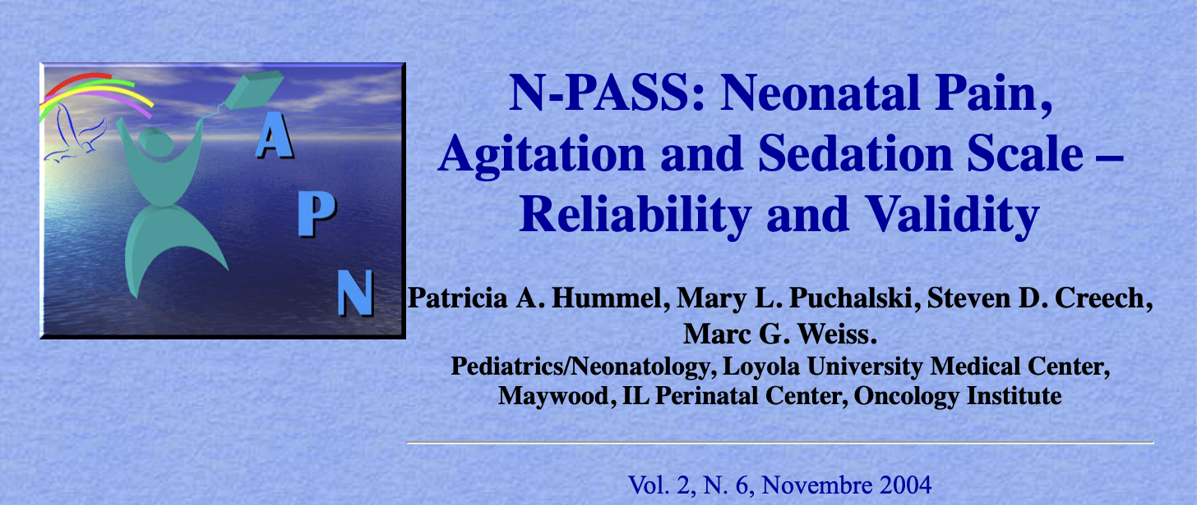
N-PASS: Neonatal Pain, Agitation and Sedation Score
To access the full N-PASS tool, as developed initially, click here.
At the bottom of the web page, click on the link to download the Microsoft word version of the tool.
Notes:
The link on this slide will take you the full description of the N-PASS tool as given by the team who developed it. At the bottom of this webpage, there is a link to download the Microsoft word version of the N-PASS tool if you want to keep one for looking at later. In the following slides we will give us a brief overview of how to use the tool for DEXTA participants.

Slide 5
N-PASS: Neonatal Pain, Agitation and Sedation Score
Assessment | Sedation |  | Normal | Pain / Agitation
Criteria | -2 | -1 | 0 | 1 | 2
Crying Irritability | No cry with painful stimuli | Moans or cries minimally with painful stimuli | Appropriate crying Not irritable | Irritable or crying at intervals Consolable | High-pitched or silent-continuous cry Inconsolable
Behaviour State | No arousal to any stimuli No spontaneous movement | Arouses minimally to stimuli Little spontaneous movement | Appropriate for gestational age | Restless, squirming Awakens frequently | Arching, kicking Constantly awake or Arouses minimally / no movement (not sedated)
Facial Expression | Mouth is lax No expression | Minimal expression with stimuli | Relaxed Appropriate | Any pain expression intermittent | Any pain expression continual
Extremities Tone | No grasp reflex Flaccid tone | Weak grasp reflex ↓ muscle tone | Relaxed hands and feet Normal tone | Intermittent clenched toes, fists or finger splay Body is not tense | Continual clenched toes, fists, or finger splay Body is tense
Vital Signs: HR, RR, BP, SaO₂ | No variability with stimuli Hypoventilation or apnea | < 10% variability from baseline with stimuli | Within baseline or normal for gestational age | ­ ↑ 10-20% from baseline SaO₂ 76-85% with stimulation – quick recovery | ­ > 20% from baseline SaO₂ ≤75% with stimulation – slow ­ Out of sync with vent
Notes:
Here is the overview of the tool. You can see, the first column, that there are 5 assessment criteria. Along the other columns, you will see the instructions on how to score for each of these criterion. The score can range from -2 to 0 to +2. The table is colour coded – the columns in yellow are scores that suggest baby is sedated, the blue column in the middle list the signs /symptoms in a baby who is in a normal state (neither sedated nor in pain) and the pink columns on the right list features that suggest the baby could be in pain or be agitated.

Slide 6
N-PASS: Neonatal Pain, Agitation and Sedation Score
Accounts for pain AND sedation status
Five categories of assessment
Each category has a possible score or -2 to 2
Total score of -10 to 10
Parents should be actively encouraged to participate in the pain assessment and management
Notes:
To summarise this overview, N-PASS accounts for both pain and sedation assessment in a single tool. It has five categories of assessment each of which can be scored ranging from -2 to +2 giving you a total score that can range from -10 to +10.
The tool is meant to be used by health care professionals with active involvement from parents who can help you determine which score to give for each criterion.

Slide 7
N-PASS: Neonatal Pain, Agitation and Sedation Score
Pain or agitation assessment
Assessment | Sedation |  | Normal | Pain / Agitation
Criteria | -2 | -1 | 0 | 1 | 2
Crying Irritability | No cry with painful stimuli | Moans or cries minimally with painful stimuli | Appropriate crying Not irritable | Irritable or crying at intervals Consolable | High-pitched or silent-continuous cry Inconsolable
Behaviour State | No arousal to any stimuli No spontaneous movement | Arouses minimally to stimuli Little spontaneous movement | Appropriate for gestational age | Restless, squirming Awakens frequently | Arching, kicking Constantly awake or Arouses minimally / no movement (not sedated)
Facial Expression | Mouth is lax No expression | Minimal expression with stimuli | Relaxed Appropriate | Any pain expression intermittent | Any pain expression continual
Extremities Tone | No grasp reflex Flaccid tone | Weak grasp reflex ↓ muscle tone | Relaxed hands and feet Normal tone | Intermittent clenched toes, fists or finger splay Body is not tense | Continual clenched toes, fists, or finger splay Body is tense
Vital Signs: HR, RR, BP, SaO₂ | No variability with stimuli Hypoventilation or apnea | < 10% variability from baseline with stimuli | Within baseline or normal for gestational age | ­ ↑ 10-20% from baseline SaO₂ 76-85% with stimulation – quick recovery | ­ > 20% from baseline SaO₂ ≤75% with stimulation – slow ­ Out of sync with vent
Notes:
Let us look at the normal to pain and agitation scores section of the table in a bit more detail.
In N-PASS, pain is assessed for each of the 5-assessment criterion individually and then added together. Pain is therefore summed up as a positive number from 0 to +10.
For each criterion, read the descriptions given in the columns with scores of 0, 1, and 2. Give the score for the description that fits your baby the best. Use the observations you have made on the baby, closest to the time when you are calculating the score to determine whether you will give 0, 1, or 2.
On slides 14 to 18, we have given further details to help you decide which score to give for each of the 5-assessment criterion.

Slide 8
N-PASS: Neonatal Pain, Agitation and Sedation Score
Pain or agitation assessment
Assess each of the 5 categories
Score each category as 0, 1 or 2
Add to obtain the total score (can be from 0 to 10)
If infants is
      <28 weeks corrected age: add 3 to the total score
      28 to 31 weeks corrected age: add 2 to the total score
      32 to 35 weeks corrected age: add 1 to the total score
Notes:
Using your observations, you can, therefore give a score for each criterion and obtain a total score by adding them up. Points are added to the premature infant’s pain score based on their gestational age because preterm infants may have a limited ability to express pain behaviourally or physiologically.
For babies whose corrected age is <28 weeks’ gestation, add 3; for those who are 28 to 31 weeks’, add 2; and for corrected age of 32 to 35 weeks, add 1.

Slide 9
N-PASS: Neonatal Pain, Agitation and Sedation Score
Pain or agitation assessment: interpretation
Total score | Interpretation | Suggested actions
0 to 3 | “normal” | Comfort measures should be in place as routine e.g., optimal positioning and environment.
3 to 5 | Some pain and discomfort | Optimise comfort measures and non-pharmacological pain management e.g., swaddling, skin-to-skin care. Involve parents in pain management where possible.
> 5 | Significant pain | Increase pharmacological management: increase morphine infusion rate, consider bolos of morphine
Notes:
You can then use the total score to determine the overall pain and agitation state of your baby. A score of 0 to 3 suggests that the baby is in a normal state and you should continue all comfort measures that are in place and that are routine good practice such as optimal positioning and environment. If the baby is on morphine infusion, you could consider reducing the morphine infusion rate.
A score of 3 to 5 suggests that the baby could be in some pain and or discomfort and you need to optimise comfort measures including non-pharmacological measures and involving parents with measures such as skin-to-skin care were appropriate and possible.
A socre of >5 suggest that the baby is in significant pain and the baby may need increase in pain medications such as more morphine as a bolos or increase in infusion rate.

Slide 10
N-PASS: Neonatal Pain, Agitation and Sedation Score
Sedation assessment
Assessment | Sedation |  | Normal | Pain / Agitation
Criteria | -2 | -1 | 0 | 1 | 2
Crying Irritability | No cry with painful stimuli | Moans or cries minimally with painful stimuli | Appropriate crying Not irritable | Irritable or crying at intervals Consolable | High-pitched or silent-continuous cry Inconsolable
Behaviour State | No arousal to any stimuli No spontaneous movement | Arouses minimally to stimuli Little spontaneous movement | Appropriate for gestational age | Restless, squirming Awakens frequently | Arching, kicking Constantly awake or Arouses minimally / no movement (not sedated)
Facial Expression | Mouth is lax No expression | Minimal expression with stimuli | Relaxed Appropriate | Any pain expression intermittent | Any pain expression continual
Extremities Tone | No grasp reflex Flaccid tone | Weak grasp reflex ↓ muscle tone | Relaxed hands and feet Normal tone | Intermittent clenched toes, fists or finger splay Body is not tense | Continual clenched toes, fists, or finger splay Body is tense
Vital Signs: HR, RR, BP, SaO₂ | No variability with stimuli Hypoventilation or apnea | < 10% variability from baseline with stimuli | Within baseline or normal for gestational age | ­ ↑ 10-20% from baseline SaO₂ 76-85% with stimulation – quick recovery | ­ > 20% from baseline SaO₂ ≤75% with stimulation – slow ­ Out of sync with vent
Notes:
On the other side of the table, in yellow, are the scores that indicate sedation level. This again ranges from the normal state which is the same as for the pain assessment to -1 and -2, scores that indicated sedation.
For each criterion, read the descriptions given in the columns with scores of 0, -1, and -2. Give the score for the description that fits your baby the best. Use the observations you have made on the baby, closest to the time when you are calculating the score to determine whether you will give 0, 1, or 2. On slides 14 to 18, we have given further details to help you decide which score to give for each of the 5-assessment criterion.

Slide 11
N-PASS: Neonatal Pain, Agitation and Sedation Score
Sedation assessment
Assess each of the 5 categories
Score each category as 0, -1 or -2
Add to obtain the total score (can be from 0 to -10)
Response to stimuli should be assessed when stimulus is given for care – baby should not be stimulated just for assessing response
Notes:
Sedation is therefore scored from 0 to -2 for each assessment criterion and then summed up to give a negative score ranging from 0 to -10. To assess response to stimuli, you can use the most recent observation – you do not need to stimulate a resting baby for assessing this response.

Slide 12
N-PASS: Neonatal Pain, Agitation and Sedation Score
Sedation assessment: interpretation
Total score | Interpretation | Suggested actions
0 to -1 | “normal” | Comfort measures should be in place as routine e.g., optimal positioning and environment.
-2 to -5 | light sedation | may be suitable for an infant on mechanical ventilation
-6 to -10 | deep sedation | Reduce pharmacological management: decrease morphine infusion rate
Notes:
Similar to the pain score, you can then use the total score to determine the overall sedation state of your baby. A score of 0 to -1 suggests that the baby is in a normal state and you should continue all comfort measures that are in place and that are routine good practice such as optimal positioning and environment.
A score of -2 to -5 suggests light sedation. This may be suitable for a baby who is mechanically ventilated but if the baby remains in this state for repeated observations, you may consider reducing the morphine infusion.
A score of -6 to -10 suggest that the baby deeply sedated and unless required for specific medical reasons such as immediate post-operative period, reduce the pain medications such as reducing the morphine infusion rate.

Slide 13
N-PASS: Neonatal Pain, Agitation and Sedation Score
Paralysis or muscle relaxation
It is not possible to behaviourally evaluate pain in a paralysed infant
Increase in heart rate and blood pressure may be the only indicator of a need for more analgesia
Notes:
Please note that it is not possible to assess N-PASS reliably in a baby who is muscle relaxed. The baby cannot express behavioural indicators such as crying and facial expression muscle tone will be flaccid due to the medication given. You can however continue to use the physiological criteria of heart rate and blood pressure as an indicator of pain e.g., Baby with persistent high heat rate could be in pain.

Slide 14
N-PASS: Neonatal Pain, Agitation and Sedation Score
Scoring criteria: crying / irritability
Score | Criteria
-2 | No response to painful stimuli e.g., No cry with needle sticks No reaction to ETT or nares suctioning No response to care giving
-1 | Moans, sighs, or cries audible or silent) minimally to painful stimuli e.g., needle sticks, ETT or nares suctioning, care giving
0 | Not irritable- appropriate crying Cries briefly with normal stimuli Easily consoled Normal for gestational age
1 | Infant is irritable/crying at intervals – but can be consoled. If intubated – intermittent silent cry
2 | Any of the following: Cry is high pitched Infant cries inconsolably If intubated – silent continuous cry
Notes:
This slide gives you more details on how you can determine the score for the first assessment criterion: crying and/or irritability. Read the description given for each score and give your baby the score for the description that is the closest match for your baby’s behaviour.

Slide 15
N-PASS: Neonatal Pain, Agitation and Sedation Score
Scoring criteria: behaviour state
Score | Criteria
-2 | Does not arouse or react to stimuli Eyes continually shut or open No spontaneous movement
-1 | Little spontaneous movement, arouses briefly and/or minimally to any stimuli Opens eyes briefly Reacts to suctioning Withdraws to pain
0 | Behaviour and state ae gestational age appropriate
1 | Any of the following: Restless, squirming Awakens frequently/easily with minimal or no stimuli
2 | Any of the following: Kicking Arching Constantly awake No movement or minimal arousal with stimulation (in appropriate for gestational age or clinical situation, i.e., post-operative)
Notes:
Similarly. this slide gives you more details on how you can determine the score for the second assessment criterion: behaviour state. Read the description given for each score and give your baby the score for the description that is the closest match for your baby’s behaviour.

Slide 16
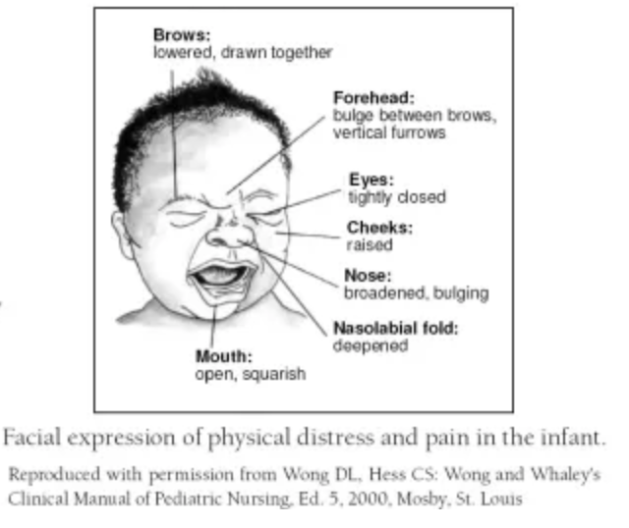
N-PASS: Neonatal Pain, Agitation and Sedation Score
Scoring criteria: facial expression
Score | Criteria
-2 | Any of the following: Mouth is lax Drooling No facial expression at rest or with stimuli
-1 | Minimal facial expression with stimuli
0 | Face is relaxed at rest but not lax – normal expression with stimuli
1 | Any pain face expression observed intermittently
2 | Any pain face expression is continual
Notes:
Next,. this slide gives you more details on how you can determine the score for the third assessment criterion: facial expression. Read the description given for each score and the image of the facial expression of physical distress and pain in the infant which is taken from the developers of the N-PASS tool. Give your baby the score for the description that is the closest match for your baby’s facial expression.

Slide 17
N-PASS: Neonatal Pain, Agitation and Sedation Score
Scoring criteria: extremities / tone
Score | Criteria
-2 | Any of the following: No palmar or plantar grasp can be elicited Flaccid tone
-1 | Any of the following: Weak palmar or plantar grasp can be elicited Decreased tone
0 | Relaxed hands and feet – normal palmar or sole grasp elicited – appropriate tone for gestational age
1 | Intermittent (<30 seconds duration) observation of toes and/or hands as clenched, or fingers splayed. Body is not tensed.
2 | Any of the following: Frequent (≥30 seconds duration) observation of toes and/or hands as clenched, or fingers splayed. Body is tense/stiff
Notes:
Next, to help assess the fourth scoring criteria, extremities and tone read the descriptions given on this slide give your baby the score for the description that is the closest match for your baby’s limb posture, movements and tone.

Slide 18
N-PASS: Neonatal Pain, Agitation and Sedation Score
Scoring criteria: vital signs: HR, BP, RR, & O2 saturations
Score | Criteria
-2 | Any of the following: No variability in vital signs with stimuli Hypoventilation Apnea Ventilated infant: no spontaneous respiratory effort
-1 | Vital signs show little variability with stimuli – less than 10% from the baseline
0 | Vital signs and/or oxygen saturations are within normal limits with normal variability – or normal for gestational age
1 | Any of the following: HR, BP, and/or RR are 10-20% above baseline With care/stimuli infant desaturates minimally to moderately (SaO₂ 76-85%) and recovers quickly (within 2 min)
2 | Any of the following: HR, BP, and/or RR are >20% above baseline With care/stimuli infant desaturates severely (SaO₂ <75%) and recovers slowly (>2 min) Infant is out of synchrony with the ventilator – fighting the ventilator
Notes:
Finally, the fifth assessment criterion includes the vital signs – heart rate, blood pressure, respiratory rate, and oxygen saturations. Use your routine observations to assess the score for this. Give the score for the vital sign that scores the worst e.g. if a bay has heart that is mildly raised (10-20% above baseline) but desaturates severely (SaO₂ <75%) and recovers slowly (>2 min) give a score of 2.

Slide 19
N-PASS: Neonatal Pain, Agitation and Sedation Score
N-PASS should be used to score and document pain and sedation level in babies who are in DEXTA while they are receiving the investigational medicinal product (IMP)
During the 120-hour IMP infusion period, infants should have N-PASS score measured at least every 2 to 4 hour and recorded
N-PASS scores of -5 to 3 signify that the baby is comfortable
N-PASS score should be interpreted in view of the baby’s clinical condition and other observations that may suggest pain or sedation
Notes:
For DEXTA, use N-PASS to score and document pain and sedation level while the baby is receiving the IMP. This will be over a 120-hour period. Please measure and record the total N-PASS score every 2 hours if possible. If not feasible, please recorded N-PASS score at least 4 hourly.
A total score of – 5 to 3 indicates that the baby is, overall, comfortable but remember to use the N-PASS score as an addition to your clinical observations and baby’s condition. You may notice other indicators that could suggest pain or sedation and you can take these into account when making decisions about increasing or decreasing pain medications.

Slide 20
Summary of N-PASS scoring
Assessment | Sedation |  | Normal | Pain / Agitation
Criteria | -2 | -1 | 0 | 1 | 2
Crying Irritability | No cry with painful stimuli | Moans or cries minimally with painful stimuli | Appropriate crying Not irritable | Irritable or crying at intervals Consolable | High-pitched or silent-continuous cry Inconsolable
Behaviour State | No arousal to any stimuli No spontaneous movement | Arouses minimally to stimuli Little spontaneous movement | Appropriate for gestational age | Restless, squirming Awakens frequently | Arching, kicking Constantly awake or Arouses minimally / no movement (not sedated)
Facial Expression | Mouth is lax No expression | Minimal expression with stimuli | Relaxed Appropriate | Any pain expression intermittent | Any pain expression continual
Extremities Tone | No grasp reflex Flaccid tone | Weak grasp reflex ↓ muscle tone | Relaxed hands and feet Normal tone | Intermittent clenched toes, fists or finger splay Body is not tense | Continual clenched toes, fists, or finger splay Body is tense
Vital Signs: HR, RR, BP, SaO₂ | No variability with stimuli Hypoventilation or apnea | < 10% variability from baseline with stimuli | Within baseline or normal for gestational age | ­ ↑ 10-20% from baseline SaO₂ 76-85% with stimulation – quick recovery | ­ > 20% from baseline SaO₂ ≤75% with stimulation – slow ­ Out of sync with vent
Notes:
You have now completed the training for how to do the N-PASS scoring for babies in DEXTA during the 120-h infusion of IMP.
In the following slides we will talk about how to use the N-PASS scores to increase or decrease the morphine infusion given along with the IMP.

Slide 21
N-PASS: Neonatal Pain, Agitation and Sedation Score
See the DEXTA ‘Guidance on Morphine Dose Reduction’ training aid
In the first 24 hours of the IMP infusion,
If N-PASS score is -5 to 3 (comfortable) or <-5 (sedated)
Reduce morphine infusion rate
Stop morphine, if appropriate
If N-PASS score is >3 or other clinical assessments suggest pain,
Consider giving a bolus dose of morphine
Increase morphine infusion rate
Continue IMP, at half rate. DO NOT reduce or stop IMP unless concerns about haemodynamic instability (see flow chart here).
Notes:
This slides talks about actions to take in the first 24 hours of the DEXTA IMP infusion.
In this first 24 hours period, the baby will be on half-rate infusion of the IMP. We have given some suggestions in more details on how to reduce the morphine infusion in a document that you can find on the DEXTA website using the link provided on this slide. You can also use your local protocol for reducing or increasing morphine infusion rates in response to pain scores.
If you get a score of -5 to 3 or if the baby is sedated that is has a score -5 or below, reduce the morphine infusion rate. If the baby is already on the lowest infusion rate for morphine and remains comfortable or sedated, stop the morphine infusion.
If the N-PASS score is >3 or other clinical assessment suggests pain, consider giving a morphine bolus and increasing the morphine infusion rate.
In this initial 24 hours, continue the IMP at half rate. Do not stop the IMP even if the baby is comfortable and you have stopped the morphine. The only reason to stop the IMP is if the baby has critical haemodynamic instability as given in the trial flow chart given on slide 22 and in the study protocol.

Slide 22
N-PASS: Neonatal Pain, Agitation and Sedation Score
During 25 to 120 hours (days 2 to 5) of the IMP infusion,
If the baby is comfortable or the N-PASS score is >3, or other clinical assessments suggest pain,
Increase IMP infusion to full rate
If N-PASS still >3 or other clinical assessments suggest pain,
  Increase morphine infusion rate, consider giving morphine bolus
If N-PASS score is -5 to 3 (comfortable) or <-5 (sedated)
Reduce morphine infusion rate
Stop morphine, if appropriate
Continue IMP, at full rate. DO NOT reduce or stop IMP unless concerns about haemodynamic instability (see flow chart here).
Notes:
After the first 24 hours, you will have increased the IMP infusion rate to full rate. During the remaining 25 to 120 hours of the IMP infusion, if the baby remains comfortable, N-PASS score is >3 indicating the baby is in pain, or other clinical assessment suggests pain, first make sure that the IMP is now running at full rate. If the N-PASS score or other clinical assessment continues to indicate that the baby is in pain, consider giving a morphine bolus and increase the morphine infusion rate.
If the N-PASS score is -5 to 3 and the baby remains comfortable or score is –5 or below showing that the baby is sedated, reduce the morphine infusion rate. If the baby is already on the lowest infusion rate for morphine and remains comfortable or sedated, stop the morphine infusion.
Do not stop the IMP even if the baby is comfortable and you have stopped the morphine. The only reason to stop the IMP is if the baby has critical haemodynamic instability as given in the trial flow chart given on slide 22 and in the study protocol.

Slide 23
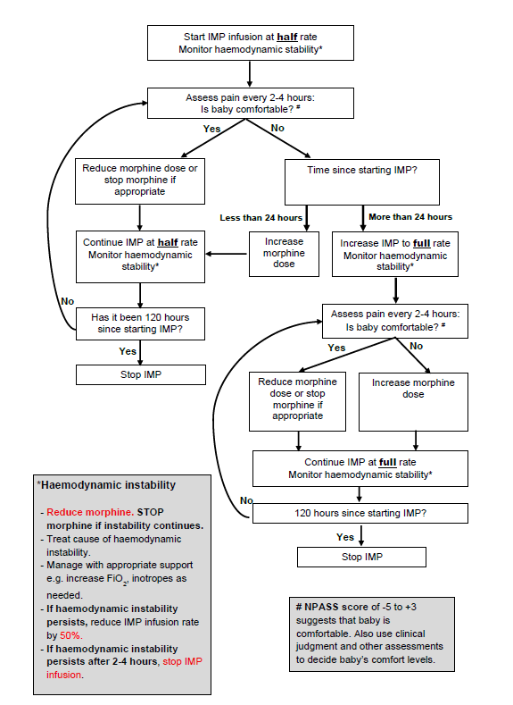
Using N-PASS in DEXTA
Measure and record N-PASS score every 2-4 hours
Ensure N-PASS is measured within 2 hours of making any change in morphine or IMP infusion
Notes:
This slide has the flow chart for DEXTA mentioned on the previous two slides. Use this with combined N-PASS and overall clinical assessment with the senior doctor and nurse to make decisions about increasing and decreasing morphine infusion rates.

Slide 24
Summary
N-PASS is a routinely used pain score, validated for use in ventilated preterm infants
It uses 5 criteria to score pain and sedation
N-PASS should be scored and recorded every 2-4 hours while the baby is on the IMP in DEXTA
Morphine should be reduced and stopped if the baby remains comfortable
IMP should be continued for 120 hours unless clinical concerns about hemodynamic instability
Notes:
In summary, ….

Slide 25
Feel free to email us: dexta@nottingham.ac.uk
Or visit the website www.dexta.ac.uk
Notes:
Thank you for listening to this training aid. Your local research nurse and Principal investigator will be able to help you if you have any questions but please do also see our website or email us directly on the email address on this slide.

