Slide 1





Site Initiation DEXTA DEXmedetomidine Trial of Adjunct Treatment with Morphine
WPD 5.8_Site Initiation Visit Slide Set Template_V4.0_09-Oct-2025

Slide 2
Agenda
Agenda Items
1. Welcome/introductions
2. Trial information
3. Participant pathway
4. Recruitment
5. Participant information and consent
6. Baseline
7. Randomisation
8. IMP
9. PK Sampling
10. Safety
11. Protocol Deviations
12. Internal Pilot
Agenda Items
13. Data Collection
14. Blinding/unblinding
15. Co-enrolment
16. Interim analysis
17. End of trial/withdrawals
18. Investigator Site File
19. Roles and responsibilities
20. Monitoring
21. Site training pack
22. Site opening checklist
23. Q&A
24. What happens next?
WPD 5.8_Site Initiation Visit Slide Set Template_V4.0_09-Oct-2025

Slide 3
Welcome/introductions
WPD 5.8_Site Initiation Visit Slide Set Template_V4.0_09-Oct-2025

Slide 4


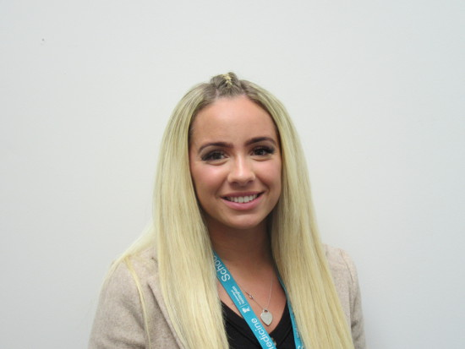


Trial team introductions
Garry Meakin
Senior Trial Manager
Shalini Ojha
Chief Investigator
WPD 5.8_Site Initiation Visit Slide Set Template_V4.0_09-Oct-2025
Megan Birchenall
Trial Manager
Jon Dorling
Co-Chief Investigator
Woo Taek Jang
Trial Coordinator

Slide 5

Trial team structure
Sponsor
Funder
Clinical Trials Unit
WPD 5.8_Site Initiation Visit Slide Set Template_V4.0_09-Oct-2025
Notes:
The study is funded by the research arm of the NHS, the National Institute for Health Research Efficacy and Mechanism Evaluation (NIHR EME) Programme.

Slide 6
Trial introduction
DEXTA
CPMS ID = 70247
IRAS Number = 1012134
WPD 5.8_Site Initiation Visit Slide Set Template_V4.0_09-Oct-2025
REC REF = 25-NI-0113
NIHR = NIHR158535
ISRCTN = ISRCTN24287322

Slide 7

Trial information
WPD 5.8_Site Initiation Visit Slide Set Template_V4.0_09-Oct-2025

Slide 8
Trial importance
Importance of the study
“A true state of equipoise exists when one has no good basis for a choice between two or more care options”
It is important that participants (families of participants) and staff are in equipoise
We do not know what is the best way to manage pain in babies born less than 32 weeks. That is why we are conducting the trial
If you have any issues with equipoise, please let us know
WPD 5.8_Site Initiation Visit Slide Set Template_V4.0_09-Oct-2025
Notes:
We are going to provide you some background to the trial to support your understanding of why we are doing this trial.
It is important for any research to not make assumptions that could influence the findings of that research. To help with this, we talk about about the principle of equipoise, where one maintains a genuine balance of appreciation of the benefits or choice between two or more interventions.
At this moment in time, we genuinely do not which is the better option to help manage pain in babies born before 32 weeks gestation.
That is why we are conducting the trial, to find this out.
It is therefore incredibly important that we maintain this state of equipoise, not making assumptions about intervention efficacy, until we have done the trial.

Slide 9
Trial background
Why we are doing the trial
Preterm babies experience pain that is often not well managed or well researched.
Providing effective pain relief is a key part of high-quality intensive care.
Mechanical ventilation is invasive and can be painful.
Morphine and fentanyl are the drugs most commonly used to manage pain in ventilated newborns but they may:
not always relieve pain effectively
slow breathing and feeding, and delay coming off the ventilator
affect long-term brain development
WPD 5.8_Site Initiation Visit Slide Set Template_V4.0_09-Oct-2025
Notes:
First, it’s important to recognise that preterm babies do feel pain, and unfortunately, their pain is often not well understood or well managed. As part of good neonatal intensive care, we must ensure that pain is treated effectively and safely.
Many babies in the neonatal unit need mechanical ventilation to help them breathe. This procedure can be uncomfortable and even painful, so pain relief is routinely given. Currently, morphine and fentanyl are the most commonly used medicines for this purpose.
However, these drugs are not perfect. Morphine, for example, doesn’t always work well for pain in babies. It can also slow a baby’s breathing and feeding, which may delay their progress and their ability to come off the ventilator. In addition, there are concerns about whether drugs like morphine could affect brain development later in life.

Slide 10
Trial background
Why we are doing the trial
Dexmedetomidine (dexmed) is a newer medicine already used in adults and children.
It may:
Provide effective pain relief with fewer side effects
Reduce the amount of morphine babies need
Therefore = we need a high-quality study to find out if it's safe and effective in preterm babies
WPD 5.8_Site Initiation Visit Slide Set Template_V4.0_09-Oct-2025
Notes:
This brings us to Dexmed, also known as dexmedetomidine. Dexmed is already used to provide sedation and pain relief in adults and older children. It works differently from morphine, acting on alpha-2 receptors in the brain. Because of this difference, Dexmed may provide good pain relief with fewer side effects, and it may also reduce the amount of morphine babies need.
But here’s the key point: although Dexmed is promising, we still don’t know enough about how safe and effective it is specifically for preterm babies on ventilators.
That’s why this study is needed. A high-quality clinical trial will give us the evidence we need to decide whether Dexmed should be part of standard care for these vulnerable babies in the future.

Slide 11
Trial details
Trial Design = A three-arm, multicentre, blinded, randomised placebo-controlled, efficacy trial with a superiority hypothesis testing framework, a built-in safety run-in period, and planned single interim analysis with integral Pharmacokinetic-Pharmacodynamic (PKPD) analysis
Three-arm
Multi-centre
RCT
Efficacy
WPD 5.8_Site Initiation Visit Slide Set Template_V4.0_09-Oct-2025
High dose, low dose and placebo
15 UK NICU
1 : 1 : 1 ratio
240 target
(1 baby per month)
Does the treatment produce the desired effect?
Notes:
This brings us to the discussion about our new trial, DEXTA. DEXTA is a three-arm, multicentre, blinded, randomised placebo-controlled, efficacy trial. It involves a superiority hypothesis testing framework, a built-in safety run-in period, and planned single interim analysis with integral Pharmacokinetic-Pharmacodynamic (PKPD) analysis. All of which will be discussed later during the training.
DEXTA is a three armed trial, with high dose dexmed, low dose dexmed, and a placebo, all paired with morphine. More information will be shared on the next slide. It is a multicentre trial, with 15 UK hospital sites (NICUs), with a target of 240 premature babies randomised on a 1 to 1 to 1 ratio. As this is an effifacy trial, we want to know what is the best way to manage pain in babies so we want to see whether Dexmed does help to reduce morphine.

Slide 12
Trial details
Trial groups
High dose dexmed (0.5mcg/kg/hr)
+ morphine
Low dose dexmed (0.25mcg/kg/hr)
+ morphine
Placebo
+ morphine
WPD 5.8_Site Initiation Visit Slide Set Template_V4.0_09-Oct-2025
OR
OR
Notes:
As mentioned on the previous slide, the trial groups will be high dose dexmed, low dose dexmed and a placebo/dummy medicine, all given with a morphine infusion. Babies will be randomly assigned to one of these treatment groups.
We want to find whether adding dexmed (one of two doses – a high and a low dose) to morphine help reduces the total amount of morphine needed.

Slide 13
Trial details
Trial outcomes
Primary outcome =
Cumulative dose of morphine given over 120 hours from starting the dexmed or placebo infusion
WPD 5.8_Site Initiation Visit Slide Set Template_V4.0_09-Oct-2025

Slide 14
Trial details
Trial outcomes
Secondary outcomes =
Over 120 hours from start of infusion | At discharge from neonatal care
pain (measured by standardised preterm pain scale) total duration of morphine infusion (in hours) use of additional morphine bolus total additional morphine (in mg/kg and number of additional boluses) morphine and dexmedetomidine Area Under the Concentration Time Curve total dose and duration of other analgesics total duration of ventilation (in hours) number of episodes of bradycardia requiring intervention heart rate (assessed hourly) blood pressure (assessed every 2 hours) oxygen saturation (assessed hourly) FiO₂ (assessed hourly) requirement of additional vasopressor support | brain injury time to reach at least 140 ml/kg/day full milk feeds (in hours) bronchopulmonary dysplasia length of intensive, high-dependency, and total neonatal care (in days) parent experience (self-reported questionnaire) Mortality Other neonatal core outcomes (late onset infection, necrotising enterocolitis, retinopathy of prematurity)
WPD 5.8_Site Initiation Visit Slide Set Template_V4.0_09-Oct-2025

Slide 15
Study details
Participant information
Inclusion criteria =
<32 weeks’ gestational age at birth AND at least 160 hours elapsed from birth
expected to require at least 48 hours of ventilation from randomisation
receiving/requiring morphine infusion
Exclusion criteria =
Mother
received any opiates during pregnancy (excluding labour)
Baby
has major congenital anomaly (clinical discretion)
is haemodynamically unstable despite receiving two or more inotropes
is highly likely to be transferred to another hospital within 5 days of randomisation
has no realistic prospect of survival (as judged by the clinical team)
contraindicated to Dexmedetomidine as per the local SmPC
history or evidence of any other medical condition that would expose the participants to an undue risk of a significant AE or interfere with study assessments during the trial (as determined by the clinical judgment of the investigator)
WPD 5.8_Site Initiation Visit Slide Set Template_V4.0_09-Oct-2025
Notes:
They can be recruited at any stage of their neonatal journey, the birth just should be less than 32 weeks.
We are excluding congenital anomalies that are likely to be fatal or likely to affect the results (e.g. affecting how they manage pain), we are not giving a definition as it should be a clinical discretion
We don’t want to include babies who are less than 7 days old

Slide 16
Trial details
Overview of the trial timelines
Milestone | Date
Site opening | February 2026
Recruitment | 24 months
End of data collection and analysis | July 2027
Report and Dissemination | Mid 2028 and 2030
WPD 5.8_Site Initiation Visit Slide Set Template_V4.0_09-Oct-2025
Notes:
On the slide, there are a few key trial details and milestones, with site opening beginning from Feb 2026, recruitment lasting 24 months, and the end of data collection, report and dissemination approaching the 2030.

Slide 17
Participant pathway
WPD 5.8_Site Initiation Visit Slide Set Template_V4.0_09-Oct-2025

Slide 18
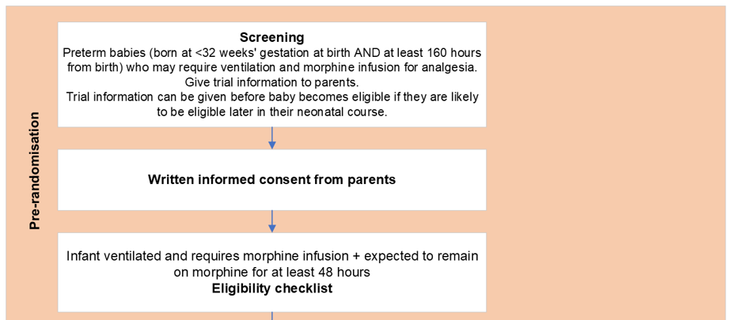
Participant pathway
WPD 5.8_Site Initiation Visit Slide Set Template_V4.0_09-Oct-2025

Slide 19
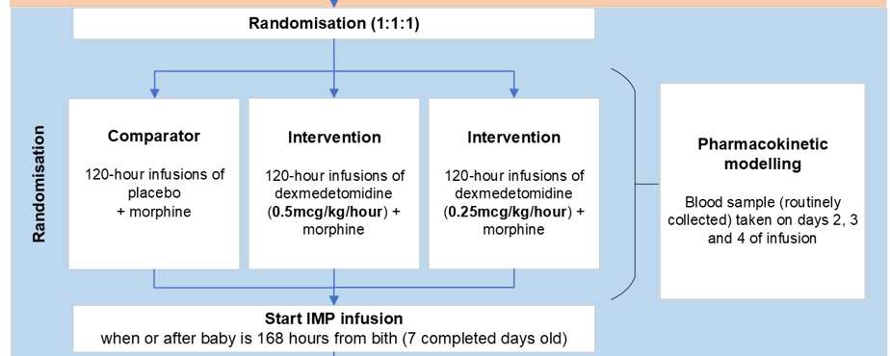
Participant pathway
WPD 5.8_Site Initiation Visit Slide Set Template_V4.0_09-Oct-2025

Slide 20
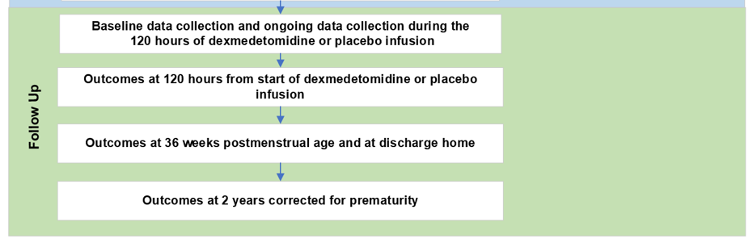
Participant pathway
WPD 5.8_Site Initiation Visit Slide Set Template_V4.0_09-Oct-2025

Slide 21
Activities on a site level
WPD 5.8_Site Initiation Visit Slide Set Template_V4.0_09-Oct-2025

Slide 22
Recruitment
WPD 5.8_Site Initiation Visit Slide Set Template_V4.0_09-Oct-2025

Slide 23
Screening
Paper version of the screening log for individual entries.
Record details of all babies who are born before 32 weeks gestation.
If the family of a baby does not consent, record the main reason for not consenting.
As babies’ eligibility may change, please monitor this during their time on the NICU. Record all details of this on the paper screening log.
In REDCap - Record screening data in the “screening log” form. Only record information on REDCap when an outcome for that baby has been reached. Ensure that only 1 reason per participant is uploaded. (See diagram on next slide)
Ensure the form status is “complete”, save and exit/go to next form.
WPD 5.8_Site Initiation Visit Slide Set Template_V4.0_09-Oct-2025
Notes:
Please make sure that you are only uploading 1 reason per participant onto REDcap.

Slide 24
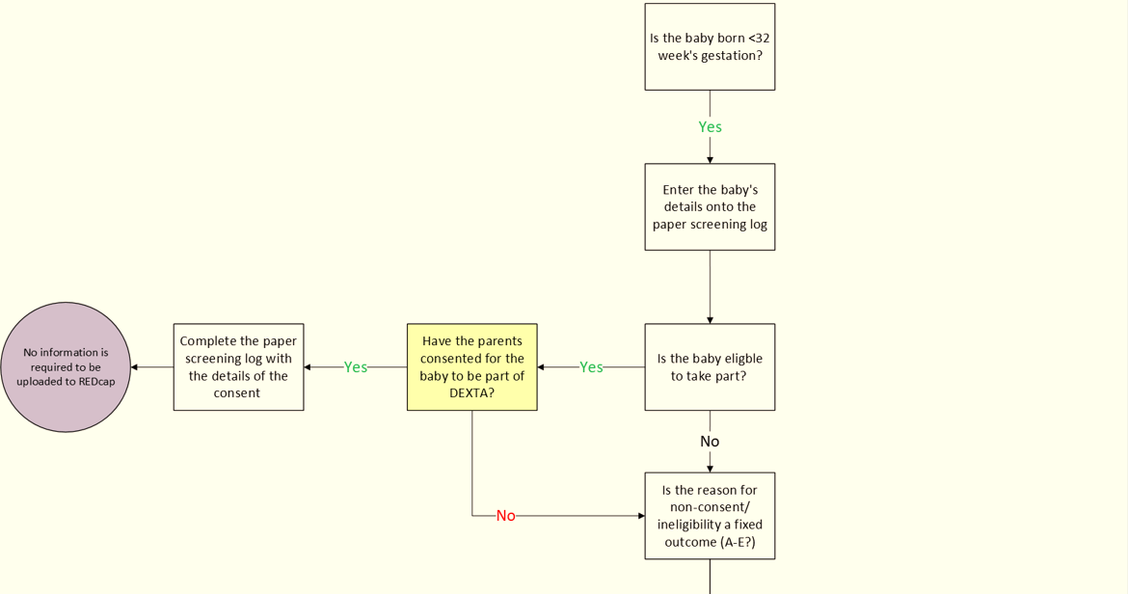
Screening
WPD 5.8_Site Initiation Visit Slide Set Template_V4.0_09-Oct-2025
Notes:
We are aware that this appears on the smaller/unclearer side, but we as part of our site training package, we will include a copy of this flow diagram.
The screening process begins by determining whether the baby was born at less than 32 weeks’ gestation; if not, no further information or upload to REDCap is required. If yes, the baby’s details are entered onto the paper screening log and eligibility for DEXTA is assessed. If the baby is eligible and parental consent is obtained, the consent details are recorded on the paper screening log and no REDCap upload is needed. If the baby is not eligible or consent is not obtained, it must be determined whether the reason is a fixed outcome (A–E); if so, the reason is recorded in the fixed outcome column of the screening log and the baby is added to the monthly screening report on REDCap. If the reason is not a fixed outcome, it is recorded as a provisional reason (F–L), and the baby continues to be screened until consent is obtained, the reason becomes a fixed outcome, or the baby is discharged or dies. If the reason later becomes a fixed outcome, or if the baby is discharged or dies, the screening log is updated with the relevant final reason and the baby is added to the monthly screening report for the appropriate month.

Slide 25
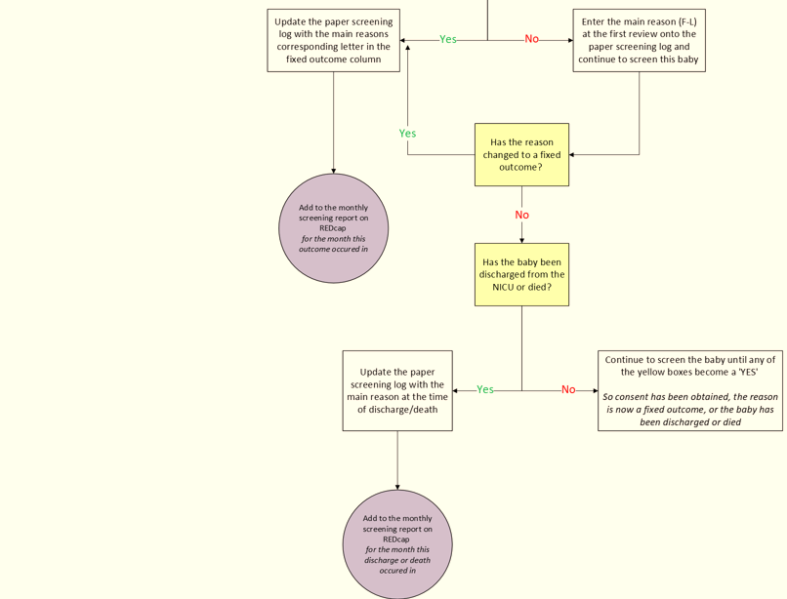
Screening
WPD 5.8_Site Initiation Visit Slide Set Template_V4.0_09-Oct-2025

Slide 26
Recruitment and retention
240 participants overall
Retention is really important.
Sites can aid retention by:
Ensure parents are aware of importance of collecting follow up data
Explain processes clearly to the parents of potential participants
Check contact details are correct and up to date for the parents/families
Notify NCTU should contact details change for any personnel participating or working on the trial.
WPD 5.8_Site Initiation Visit Slide Set Template_V4.0_09-Oct-2025

Slide 27
Participant information and consent
WPD 5.8_Site Initiation Visit Slide Set Template_V4.0_09-Oct-2025

Slide 28
Participant approach
Participant information and consent
Use the Parent Information Sheet (PIS) to facilitate a conversation with the parents/families.
There is an animation video also available to accompany this PIS. This will have translated subtitles to 10 languages.
Remain in equipoise and encourage this in communications
Give enough time for parents to ask questions and consider participation
Consent can be taken prior to eligibility being confirmed. In these instances, please make sure to explain to parents that their baby(s) might not be in the trial if they later become ineligible.
WPD 5.8_Site Initiation Visit Slide Set Template_V4.0_09-Oct-2025
Notes:
Use the Participant Information Sheet (PIS) to facilitate a conversation with the parents/families of potential participants around consent to the study.

Slide 29
Participant approach
Participant information and consent
If the parents are happy for their baby to take part, consent can be taken by a delegated member of staff. Consent will be via paper only.
Please remember that consent must be taken by the mother only.
WPD 5.8_Site Initiation Visit Slide Set Template_V4.0_09-Oct-2025

Slide 30
Consent
Consent can be taken by trained and delegated health care professionals (dependent on what is approved at your Trust)
Investigator (or delegate) must sign and date Informed Consent Form (ICF) in presence of mother (i.e. on same day)
Ensure the mother completes the ICF properly. E.g. initials in the boxes
Copies of the consent form should go to the mother, be included in the baby’s medical notes, NCTU (via REDCap upload) and the site file.
Mothers must complete their name and the date section themselves at the time of signing – this should not be prepared in advance
Completed paper ICFs must be uploaded to REDCap and retained as source data
Optional questions must also be completed
WPD 5.8_Site Initiation Visit Slide Set Template_V4.0_09-Oct-2025

Slide 31
Baseline
WPD 5.8_Site Initiation Visit Slide Set Template_V4.0_09-Oct-2025

Slide 32
Baseline
Baseline
Once the main trial informed consent is obtained from the mother, proceed to baseline:
Baseline measures/data
The baseline measures needs to be completed and entered by appropriately trained staff on REDCap
Following baseline, proceed to randomisation.
Please note: some baseline measures can be collected post-randomisation. Demographics part 1 must be completed before randomisation.
WPD 5.8_Site Initiation Visit Slide Set Template_V4.0_09-Oct-2025

Slide 33
Randomisation
WPD 5.8_Site Initiation Visit Slide Set Template_V4.0_09-Oct-2025

Slide 34

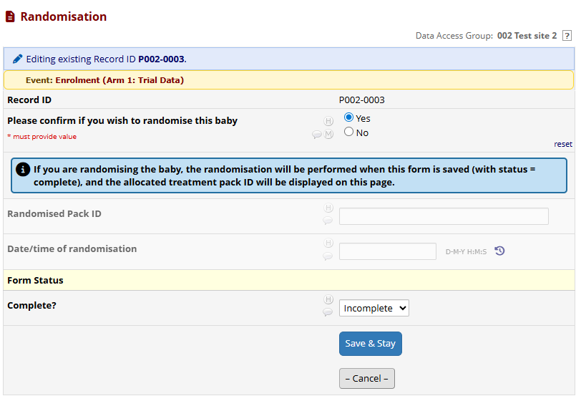
Randomisation
All study data is captured in REDcap
Randomisation is completed by the NICU staff.
Randomisation can only take place once consent, eligibility and baseline (part) are completed.
Confirmation of eligibility needs to be at the point of randomisation
All site staff will be blinded to the treatment arm.
Add image here of redcap randomisation form
WPD 5.8_Site Initiation Visit Slide Set Template_V4.0_09-Oct-2025
Notes:
Some baseline data needs to be completed prior to randomisation – demographics part 1 – and the rest can be reported past

Slide 35
In summary
Screening
Screening log data uploaded when a baby reaches a fixed outcome
Informed consent
Upload consent form
WPD 5.8_Site Initiation Visit Slide Set Template_V4.0_09-Oct-2025
Baseline
Data collection and baseline questionnaire
Randomisation
Performed by the site staff and pack ID allocated

Slide 36
IMP
WPD 5.8_Site Initiation Visit Slide Set Template_V4.0_09-Oct-2025

Slide 37
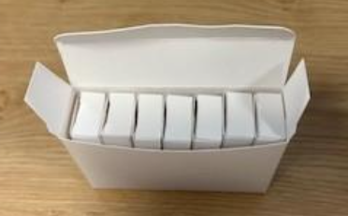
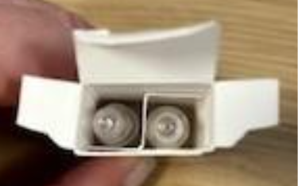
IMP
Dexmed
Please refer to the DEXTA IMP manual for information
The IMP will be supplied in blinded ampoule pairs with identical packaging.
The ampoules will be 2ml
Each kit contains 7 pairs of ampoules, only 5 will be needed for the infusion
There are 2 spares to allow for spillage / breakage
WPD 5.8_Site Initiation Visit Slide Set Template_V4.0_09-Oct-2025
Notes:
Explain that we will not be providing a pharmacy manual but they will have access to an imp manual

Slide 38
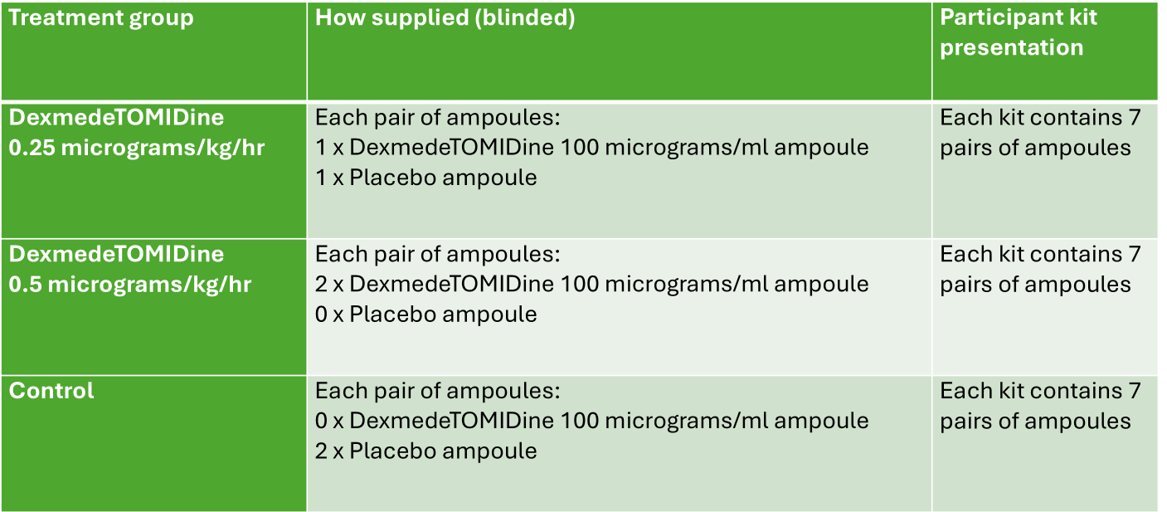
IMP
Ampoule pairs
WPD 5.8_Site Initiation Visit Slide Set Template_V4.0_09-Oct-2025

Slide 39
IMP
Supply and ordering
The initial order = 12 IMP packs sent to site pharmacy
Subsequent orders will be managed by the CTU as part of our monitoring
New orders will be placed when one of the treatment arms stock reaches 1 pack
New orders will supply 6 IMP packs
Orders received before 12:00 are processed the next day and dispatched the following day
Orders received after 12:00 are processed on day 2 and shipped the following working day
WPD 5.8_Site Initiation Visit Slide Set Template_V4.0_09-Oct-2025

Slide 40
IMP
Receipt
Receipt of the IMP will be logged in site-level IMP Accountability Log and REDCap’s pack management system
A transfer will need to be done to move the IMP into the neonatal unit storage location if the IMP is being stored in the NICU
If the IMP is being stored in the NICU, mark it as received when it reaches the NICU not when it arrived in Pharmacy
WPD 5.8_Site Initiation Visit Slide Set Template_V4.0_09-Oct-2025

Slide 41
IMP
Storage and temperature excursions:
The recommended storage conditions for IMP packs are:
Below 25°C
Store in original packaging to protect from light
During transportation: for any temperature excursions during the transportation of the IMP from Sharp to your site, if the monitor is triggered, you will be required to follow the specific instructions. These will be provided to you as part of your training package.
During storage within the pharmacy/NICU: The IMP will need to be separated from standard stock and accessible 24/7 to support recruitment. Each trial site is responsible for ensuring that temperature monitoring of the storage area is conducted in accordance with local policies and standard clinical practice.
WPD 5.8_Site Initiation Visit Slide Set Template_V4.0_09-Oct-2025
Notes:
The IMPs must be stored below 25°C and must be protected from light.
For any temperature excursions during the transportation of the IMP from Sharp to your site, if the monitor is triggered, you will be required to follow the specific instructions. These will be provided to you as part of your training package.
The IMP will need to be separated from standard stock and accessible 24/7 to support recruitment.
Each trial site is responsible for ensuring that temperature monitoring of the storage area is conducted in accordance with local policies and standard clinical practice.

Slide 42
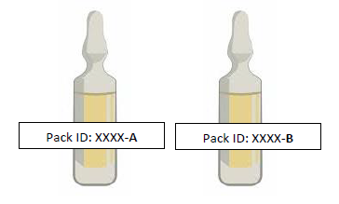
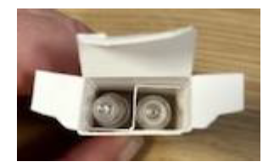
IMP
Preparation
The pack ID will be provided as soon as randomisation is complete. The pack ID will ensure that blinding is maintained
Use the ampoule pair (A + B) according to the baby’s weight band
Dilute with 5% Glucose or 0.9% sodium chloride
Use immediately after preparation (IV syringe should be changed every 24h)
WPD 5.8_Site Initiation Visit Slide Set Template_V4.0_09-Oct-2025

Slide 43
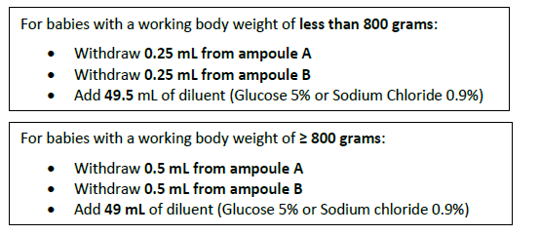
IMP
Dilusion differences
Using aseptic technique, prepare a 50mL infusion syringe according to the baby’s working body weight as follows:
WPD 5.8_Site Initiation Visit Slide Set Template_V4.0_09-Oct-2025

Slide 44
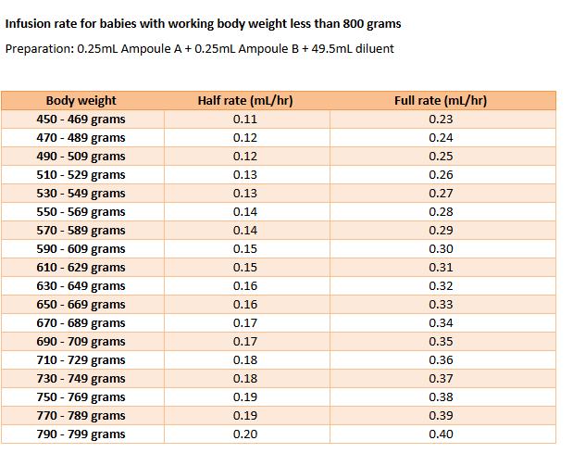
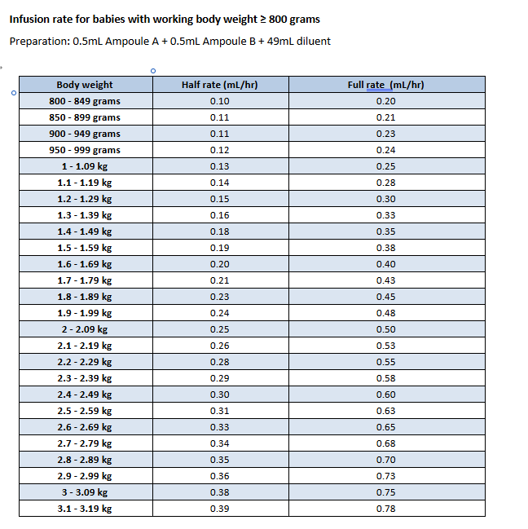
IMP
WPD 5.8_Site Initiation Visit Slide Set Template_V4.0_09-Oct-2025

Slide 45
IMP
Administration
Begin the infusion when the baby is at least 168 hours old and as close to randomisation as possible.
The infusion can begin at any time during the day. This will count as day 1.
Infuse at half the target rate for the first 24 hours then follow the titration guide
Follow titration guide for pain and haemodynamic stability (this is provided in the IMP manual)
WPD 5.8_Site Initiation Visit Slide Set Template_V4.0_09-Oct-2025

Slide 46
IMP
Dose modification and infusion guide
A flowchart to guide IMP and morphine rate titration is provided in the IMP manual.
There is also a morphine reduction guidance document that will be shared as part of the training pack that sites can use if they would like further guidance about how to reduce morphine levels.
Tables are provided in the IMP manual to ensure clinical staff know exactly at what rate they should be infusing according to the baby’s weight.
WPD 5.8_Site Initiation Visit Slide Set Template_V4.0_09-Oct-2025

Slide 47
IMP
Return and recall procedures
Used ampoules need to be discarded as per local waste policies
Unused ampoules need to be returned to pharmacy and logged in REDCap
Damaged packs = quarantine and notify CTU immediately
Drug recall instructions issued by CTU
WPD 5.8_Site Initiation Visit Slide Set Template_V4.0_09-Oct-2025

Slide 48
IMP
Y site compatibility
Compatible with: adrenaline, atracurium, caffeine citrate, calcium gluconate, morphine, etc.
Not compatible with: amphotericin B, diazepam, ketamine
Separate infusion preferred for TPN, fat emulsion, sodium bicarbonate
Full compatibility list is available in the appendix
WPD 5.8_Site Initiation Visit Slide Set Template_V4.0_09-Oct-2025
Notes:
If possible then don’t give it via the same line as morphine – but don’t canulate the baby to give the IMP
It is peripheral – it can go centrally

Slide 49
Pharmacokinetic (PK) sampling
WPD 5.8_Site Initiation Visit Slide Set Template_V4.0_09-Oct-2025

Slide 50
PK sampling
Blood collection
3 blood samples to be taken from start of treatment on days 2, 3, and 4.
These are to be taken alongside routine bloods already being collected for the baby's clinical care. Ensure this is communicated clearly with families.
They can be taken at any time of the day.
0.3 to 0.5ml per sample (depending on baby’s weight): Babies <700 g weight should have 0.3ml per sample; Babies weighing 700g and above should have 0.5ml per sample
There is PK sampling data collection on REDcap. Please ensure that you log the details of the sampling on days 2,3 and 4 on REDcap.
WPD 5.8_Site Initiation Visit Slide Set Template_V4.0_09-Oct-2025
Notes:
Please make it clear to families that their babies will have blood taken alongside routine bloods

Slide 51
PK sampling
Logistics
Blood tubes (EDTA and amber propylene screw-cap tubes) will be provided by the NCTU for use.
Once collected, the plasma will need to be separated. This can be done in a biochemistry lab or on the unit if facilities are available:
Separate plasma by centrifuging at 3,500 rpm at room temperature for 15 minutes and extract the plasma and transfer to amber tubes.
Please use the labels provided to record the details of the sample and participant. Ensure that the exact time of collection is written on the tube.
WPD 5.8_Site Initiation Visit Slide Set Template_V4.0_09-Oct-2025

Slide 52
PK sampling
Logistics
Freeze at -80 degrees within 120 minutes.
If needed:
The whole blood can be stored in refrigerator for no more than 5 days before centrifugation and freezing.
After a blood sample is spun, plasma can be stored at -20 degrees for up to 5 days (if needed e.g. over a bank holiday weekend) before being transferred to a -80 degrees freezer.
WPD 5.8_Site Initiation Visit Slide Set Template_V4.0_09-Oct-2025

Slide 53
PK sampling
Logistics
A courier will be arranged approximately every 5 months for sample collection.
Please let us know how organising this shipment will work at your site for example:
Who we are best to communicate with?
Who will organise the collection locally to ensure the samples are packed and ready?
We will document this discussion in the SIV report.
WPD 5.8_Site Initiation Visit Slide Set Template_V4.0_09-Oct-2025

Slide 54
PK sampling
PK sampling manual
A PK sampling manual will be provided. Please follow this manual for information on the PK sampling collection, processing, storage and transportation.
Any temperature excursions that occur for the samples, please ensure this is recorded in the lab processing form (appendix 1 of the PK sampling manual).
For each shipment of samples, please ensure that a copy of the lab processing form is included in the shipment, uploaded to REDcap, and filed in the site file.
WPD 5.8_Site Initiation Visit Slide Set Template_V4.0_09-Oct-2025

Slide 55
Safety
WPD 5.8_Site Initiation Visit Slide Set Template_V4.0_09-Oct-2025

Slide 56
Safety
SAEs and safety
Do NOT report expected SAEs on an SAE form
Known complications of prematurity, dexmedetomidine or morphine
Events listed as trial outcomes.
Report ONLY events that meet the definition of an SAE via the electronic SAE form in REDCap. Ensure that this is submitted within 24 hours of becoming aware of the event
Investigator responsibilities
Assess causality
Assess severity
Sign the form electronically
REDCap will generate a unique SAE reference number and notify the NCTU
WPD 5.8_Site Initiation Visit Slide Set Template_V4.0_09-Oct-2025

Slide 57
Safety run-in
Safety run-in period
Purpose = Early review of safety processes prior to the main trial, for a minimum of 2 participants per active treatment arm
Safety Observation = From the beginning of IMP infusion to 72 hours post-infusion.
Review & Decisions = the DMC will review the data once ≥2 patients per arm complete 72-hour observation. The DMC will provide recommendations to TSC based on charter.
If Stopped = Trial may only resume after regulatory authority approval of a substantial amendment
We will provide regular communications to sites during this safety run in period about the progress.
WPD 5.8_Site Initiation Visit Slide Set Template_V4.0_09-Oct-2025
Notes:
The purpose of the pre-planned safety run-in phase is to ensure we have early oversight of safety processes before we move into the main trial. In this phase, each active treatment arm will recruit a minimum of two participants.
Each run-in participant will be monitored closely for pre-specified safety outcomes from the beginning of the IMP infusion and continuing for 72 hours afterward. This timeframe represents the critical window for acute safety events. In most cases, monitoring will take place while the baby is in hospital; however, if discharge occurs earlier or the baby is transferred to another hospital, daily clinical checks and direct communication will ensure safety data are still collected.
The DMC will review safety data once at least two babies per active treatment group complete that 72-hour window. Following review, the DMC will provide a recommendation to the Trial Steering Committee, who will make the final decision according to the study charter.
There are several predefined stopping rules. If any of these occur, the trial may be paused. In such a situation, the study can only restart once a substantial amendment has been approved by the regulatory authority.

Slide 58
AE reporting
Adverse event reporting
CTCAE V6.0 - https://dctd.cancer.gov/research/ctep-trials/trial-development
Grade 1 Mild; asymptomatic or mild symptoms; clinical or diagnostic observations only; intervention not indicated.
Grade 2 Moderate; minimal, local or noninvasive intervention indicated; limiting age- appropriate instrumental ADL*.
Grade 3 Severe or medically significant but not immediately life-threatening; hospitalization or prolongation of hospitalization indicated; disabling; limiting self care ADL or severe impact on age appropriate normal daily activity (pediatric) **.
Grade 4 Life-threatening consequences; urgent intervention indicated.
Grade 5 Death related to AE.
Pediatric Activities of Daily Living (ADL):
*Mild/moderate impact on age-appropriate normal daily activity.
**Severe impact on age-appropriate normal daily activity.
https://dctd.cancer.gov/research/ctep-trials/for-sites/adverse-events/ctcae-v6.pdf
WPD 5.8_Site Initiation Visit Slide Set Template_V4.0_09-Oct-2025
Notes:
As part of the requirements from the MHRA for our stopping rules for the safety run in period, we are required to grade AEs based on the CTCAE. For the purpose of DEXTA, we are using version 6.
5 of our DEXTA AEs have a specific CTCAE grading to follow and the other 5 AEs will use the ‘other’ criteria, listed on the slide.
We have included a summary of the grading on the slides. However, a more in depth document, as part of the training pack will explain the AE reporting.
The CTCAE grading system was developed for an adult oncology population and therefore some criteria are not directly appropriate for preterm/neonatal inpatients. For each adverse event, a DEXTA interpretation row has been added to outline suggested neonatal/preterm guidance for reporting within this trial. These suggestions support consistent AE reporting and do not replace clinical guidelines or management decisions.

Slide 59
Protocol Deviations
WPD 5.8_Site Initiation Visit Slide Set Template_V4.0_09-Oct-2025

Slide 60
Protocol Deviations
The following are examples of a deviation of the protocol and are not permitted:
Inclusion/exclusion criteria deviation
Participants mother did not provide written informed consent before undergoing trial procedures/ data collection
If any protocol deviation is identified, please contact us so it can be appropriately managed
If unsure, please get in touch = dexta@nottingham.ac.uk
WPD 5.8_Site Initiation Visit Slide Set Template_V4.0_09-Oct-2025

Slide 61
Internal pilot
WPD 5.8_Site Initiation Visit Slide Set Template_V4.0_09-Oct-2025

Slide 62
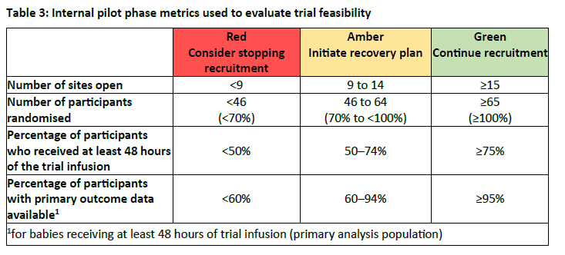
Internal pilot
WPD 5.8_Site Initiation Visit Slide Set Template_V4.0_09-Oct-2025
Notes:
The pilot phase assessment criteria (Table 3) will be used to determine the progression of the trial, 9 months after the first site opens (unless agreed otherwise with the funder).

Slide 63
Data Collection
WPD 5.8_Site Initiation Visit Slide Set Template_V4.0_09-Oct-2025

Slide 64
Data Collection
 | Enrolment | Randomisation | Post-randomisation |  |  |  |  |  | Follow-up
Timepoint | -t₁ | 0 | Day1 | Day 2 | Day 3 | Day 4 | Day 5 | 36 weeks’ PMA or discharge | 2 years of age corrected for prematurity
Eligibility Screen | X
Written informed consent | X
Randomisation |  | X
Assessments during 120 hour of IMP infusion (site staff to complete on REDcap) |  |  | X | X | X | X | X
Parental experience questionnaire |  |  |  |  |  |  |  | X
Assessments at discharge (site staff to complete on REDcap) |  |  |  |  |  |  |  | X
Assessment at 2 years corrected age (questionnaire to the parents) |  |  |  |  |  |  |  |  | X
WPD 5.8_Site Initiation Visit Slide Set Template_V4.0_09-Oct-2025
Notes:
Add table of time points here – so parental experience q, 2 year follow-up

Slide 65
Data Collection
Primary outcome measure (POM) = cumulative dose of morphine over the 120-hour infusion period.
This data collection comes from information provided by sites. So please try to ensure a timely and accurate reporting of this.
This data will be monitored to review the % of reported POM.
WPD 5.8_Site Initiation Visit Slide Set Template_V4.0_09-Oct-2025
Notes:
Add

Slide 66
Data Collection
Secondary outcome measures =
Via:
Reporting during the 120-hour infusion period (hourly monitoring)
At discharge from neonatal care
Parental experience questionnaire
2 year corrected age
Some of this data collection comes from information provided by sites. So please try to ensure a timely and accurate reporting of this.
WPD 5.8_Site Initiation Visit Slide Set Template_V4.0_09-Oct-2025

Slide 67
Data Collection
Hourly monitoring during the 120-hour infusion period =
Please begin the hourly monitoring 1 hour after the infusion has begun
Date of first sustained extubation = the date and time needs to be recorded as the time point in which the ET tube is removed from the baby and not the time point of when the 24h has been reached. Please ensure this is entered into the database once the 24h is confirmed.
The information in these forms is routinely collected so therefore it can be entered retrospectively.
Training materials will be available for N-PASS
Please ensure that no other fluids such as maintenance or glucose bolos should be included.
WPD 5.8_Site Initiation Visit Slide Set Template_V4.0_09-Oct-2025
Notes:
These are just some important points/reminders about the 120 monitoring window.

Slide 68
Data Collection
Parental experience questionnaire = questionnaire completed between end of infusion period until discharge
This is site led
Ensure that parents complete this questionnaire and then the information is entered onto the REDcap database. To aid this, we recommend you printing it off and giving it to the parents once the 5 day infusion has finished.
This can be collected from the end of treatment up until neonatal discharge.
If you fail to collect this, please ring the parents to collect this over the phone. Please try to contact them at least 3 times until this is marked as incomplete.
WPD 5.8_Site Initiation Visit Slide Set Template_V4.0_09-Oct-2025
Notes:
Add

Slide 69
Data Collection
Participant follow-up = parent reported questionnaires 2 years corrected age
The questionnaire will be collected by the parents via: an online link, or a paper form that is sent back to the NCTU using a pre-paid envelope (NCTU)
Follow-up includes email and text reminders to parents to complete these (NCTU).
There is funding for sites to help with the collection of the 2 year questionnaire (30 minutes)., via phone if no response is given from the parents via text or post (NCTU)
WPD 5.8_Site Initiation Visit Slide Set Template_V4.0_09-Oct-2025
Notes:
Add

Slide 70
Source Data
Most of the data for DEXTA will be captured directly within the REDCap database
Screening log, data collection sheets and the database will be considered source data (details in Source Data Location Log)
Medical records must evidence:
Discussions about the trial
Consent process, consent form and confirmation of consent
Details of any adverse events and associated actions
WPD 5.8_Site Initiation Visit Slide Set Template_V4.0_09-Oct-2025

Slide 71
Data Entry
DEXTA REDCap database link = https://redcap01.nottingham.ac.uk/
Database entry includes:
Screening form
Participant Information Sheet
Informed Consent Form
Record at baseline:
Mothers contact details
Demographic information
Medical history
Baseline measures
WPD 5.8_Site Initiation Visit Slide Set Template_V4.0_09-Oct-2025

Slide 72
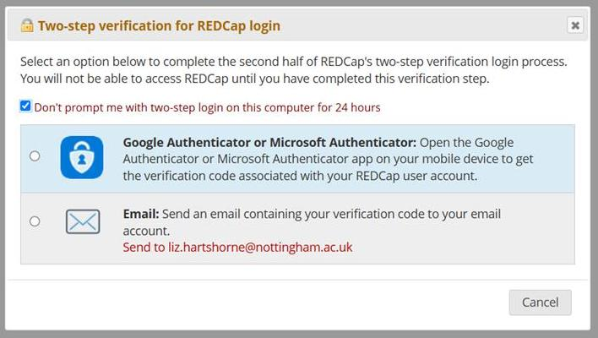
REDCap
REDCap
Two-factor authentication is required for access to REDCap
WPD 5.8_Site Initiation Visit Slide Set Template_V4.0_09-Oct-2025

Slide 73
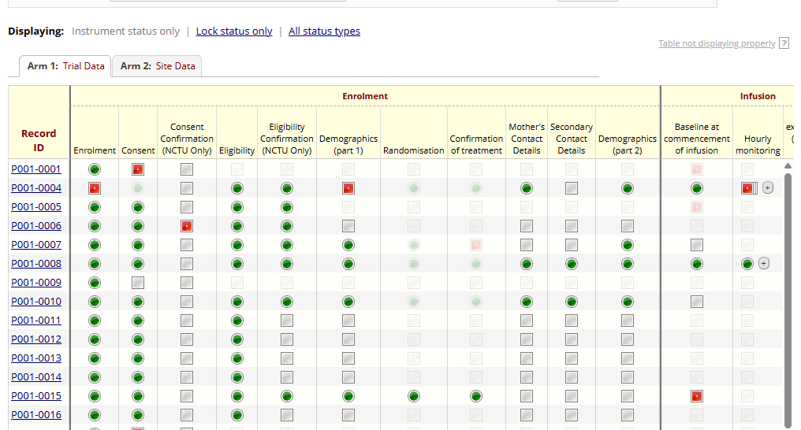
REDCap
WPD 5.8_Site Initiation Visit Slide Set Template_V4.0_09-Oct-2025
Notes:
Add images from REDcap once database is ready

Slide 74
Blinding / unblinding
WPD 5.8_Site Initiation Visit Slide Set Template_V4.0_09-Oct-2025

Slide 75
Blinding and unblinding
Information on blinding can be found in the DEXTA protocol, in section 6.2.
Site staff will be blinded for the duration of the trial.
NCTU trial management, and the Chief investigators will be blinded.
The data team will be blinded.
The database systems developer, will not be blinded as they will control the pack management system.
There is an emergency unblinding procedure (please see 6.5 in the protocol). This will need to be completed in REDCap, and a notification will then go to the relevant teams to review.
WPD 5.8_Site Initiation Visit Slide Set Template_V4.0_09-Oct-2025

Slide 76
Co-enrolment
WPD 5.8_Site Initiation Visit Slide Set Template_V4.0_09-Oct-2025

Slide 77
Co-enrolment
Participants currently cannot be enrolled in any other CTIMP
Co-enrolment with non-interventional studies (e.g., observational) is allowed
Other trials without an IMP may be allowed
A decision will be made on a case-by-case basis. This will involve a discussion with both TMGs, CI agreement between both trials and a signed co-enrolment agreement.
Please let us know if there is a study that you wish us to investigate co-enrolment with.
Currently, there are no co-enrolment agreements in place. We will ensure sites are informed of any co-enrolment decisions.
WPD 5.8_Site Initiation Visit Slide Set Template_V4.0_09-Oct-2025
Notes:
DEXTA is a CTIMP, a Controlled Trial of an Investigational Medicinal Product. Because of this, babies who are currently taking part in another CTIMP cannot be enrolled into our trial. Likewise, once a baby is enrolled in our study, they will not be able to join any other CTIMP while they remain a participant with us.
However, participation in non-interventional research, such as observational studies, is allowed. It may also be possible for babies to take part in other trials where the intervention is not an investigational medicinal product. These situations will be considered on a case-by-case basis.
If co-enrolment is being explored, we will first discuss this with the Trial Management Group. Then, agreement must be reached between the Chief Investigators of both studies, and a formal co-enrolment agreement will be signed.
Please let us know if there are any ongoing trials at your hospital that we may be able to co-enrol with and we will investigate this further.
Finally, once any co-enrolment decisions are made, we will ensure that all sites are clearly informed so they can implement the correct approach.

Slide 78
Interim analysis
WPD 5.8_Site Initiation Visit Slide Set Template_V4.0_09-Oct-2025

Slide 79
Interim analysis
At 120 babies, an interim analysis will be conducted
Once 120 babies are randomised and their cumulative dose of morphine data is complete, the interim analysis will take place.
The purpose is to assess futility only, so early stopping if Dexmed isn’t showing to reduce morphine use.
This will be conducted by an independent statistician.
The results will be reviewed by the independent DMC and they may recommend stopping one or both Dexmed doses.
If recruitment to one of the active doses of dexmed arms is stopped following the interim analysis, randomisation will continue to the remaining options using a 1:1 allocation ratio.
Results of the interim analysis will be shared with sites.
WPD 5.8_Site Initiation Visit Slide Set Template_V4.0_09-Oct-2025
Notes:
During this trial, we will have one interim analysis. This will take place once 120 babies have been randomised, which is halfway to our planned maximum sample size. We also need to have complete data for these babies on their cumulative morphine dose for the first 120 hours after starting the infusion.
The purpose of this interim analysis is to assess futility only. In other words, we want to understand whether either dose of dexmedetomidine appears unlikely to reduce morphine use compared to placebo.
The results of this interim analysis will be seen only by the DMC. They will review the findings and decide whether one or both of the dexmedetomidine doses should be stopped if there is no sign of reduced morphine use. Their recommendation will then go to the Trial Steering Committee, who will make the final decision and inform the Trial Management Group, sponsor, and funder.
If one dose is stopped after the interim analysis, randomisation will continue as usual, but using a 1:1 allocation between the remaining groups.
The interim analysis is an important safeguard. It helps ensure we are only continuing with doses that have the potential to benefit these babies, while maintaining the integrity of the trial.
We will ensure that the results of the analysis are communicated with sites.

Slide 80
End of trial/withdrawals
WPD 5.8_Site Initiation Visit Slide Set Template_V4.0_09-Oct-2025

Slide 81
Withdrawals
Participants can discontinue treatment, stop any further data collection or withdraw completely from all trial activities.
Please notify NCTU of any change in level of participation or full withdrawal
Participants may wish to stop some trial activities but can remain in the trial:
Discontinue from trial IMP
= Still complete follow-up questionnaires
Discontinue from follow-up questionnaires
= Still receive the IMP
Discontinue from trial communications
= Continue to receive follow-up questionnaires
Full withdrawal from trial
= Existing data will still be used
WPD 5.8_Site Initiation Visit Slide Set Template_V4.0_09-Oct-2025

Slide 82
End of trial
The end of trial will be the final database lock. ​
The end of participant involvement in the study will be the last data collection (at 2 years corrected age) of the last participant. ​
NCTU will notify REC that the trial has ended within 90 days of the end of study. ​
Where the trial has terminated early, NCTU will inform REC within 15 days of the end of study. ​
NCTU will provide them with a summary of the clinical trial report within 12 months of the end of study.
WPD 5.8_Site Initiation Visit Slide Set Template_V4.0_09-Oct-2025

Slide 83
ISF (Investigator Site File)
WPD 5.8_Site Initiation Visit Slide Set Template_V4.0_09-Oct-2025

Slide 84
ISF
NCTU will provide site with an Investigator Site File (ISF)
Maintenance of the ISF should be delegated on the delegation log
The ISF must contain all study records for the site:
Protocol (all versions)
Participant documents
Approvals (local and study)
Agreements
Signed consent forms
Delegation logs and training records
Staff CVs and GCP certificates
Monitoring records
Investigator meeting/initiation reports
WPD 5.8_Site Initiation Visit Slide Set Template_V4.0_09-Oct-2025

Slide 85

Delegation Log
Ensure accurate completion of the delegation log on REDCap.
Use the responsibility codes on the delegation log to enter the codes.
The PI must authorise all personnel working on the trial and sign/date the log.
Only the PI has overall responsibility of the trial, so must add all codes.
WPD 5.8_Site Initiation Visit Slide Set Template_V4.0_09-Oct-2025

Slide 86

GCP and CVs
Anyone working on the trial must have a signed and dated CV (a short research CV - template can be provided by the NCTU team if required).
The CV must have been updated within the last 2 years.
All members of staff on the delegation log must have completed GCP training within the last 3 years
CVs and GCP certificates must be filed in the ISF
PI CV and GCP must be sent to the DEXTA team.
WPD 5.8_Site Initiation Visit Slide Set Template_V4.0_09-Oct-2025

Slide 87
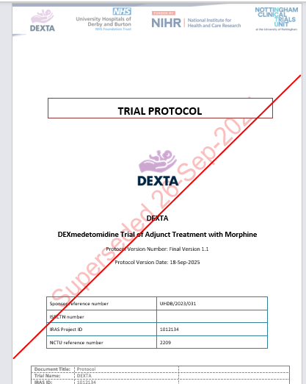
GCP document policy
Dates and Signatures
GCP requires that all dates should be written in the format dd-mmm-yyyy e.g. 24-Oct-2025
The NCTU signature policy requires either wet ink and scans sent to the NCTU OR verified e-signature using either DocuSign or Adobe Sign
Superseding documents
Single line strikethrough​
Write ‘SUPERSEDED’ in large letters along the line​
Write the date superseded: dd-mmm-yyyy​
Leave this document in the ISF
WPD 5.8_Site Initiation Visit Slide Set Template_V4.0_09-Oct-2025

Slide 88
Roles and responsibilities
WPD 5.8_Site Initiation Visit Slide Set Template_V4.0_09-Oct-2025

Slide 89
Roles and responsibilities
Site responsibilities
Medical care of participants
Work in accordance with the approved trial protocol
Comply with all ethical and legal requirements
Ensure consistency and completeness of data
Keeping and retaining accurate records
Using secure storage facilitates for participant and trial documents
NCTU responsibilities
Trial management
Data management
Trial oversight and monitoring
WPD 5.8_Site Initiation Visit Slide Set Template_V4.0_09-Oct-2025
Notes:
Here’s a quick overview of the defined roles and responsibilities between the site team and NCTU. This helps make sure everyone knows who’s responsible for what, and that the study runs smoothly and consistently across all sites. The next slide also lists the PI responsibility.

Slide 90
PI responsibilities
PI responsibilities (These can be delegated)
Legal responsibility for study conduct and patient safety at site
Participant confidentiality
Source document retention
Investigator site file maintenance
Protocol deviations
Maintain a list of staff and delegated duties
Ensure staff changes are reported to the Trial Manager
Ensure adequate lines of communication with the Trial Manager and NCTU
eCRF final sign off
Permit monitoring, audit and inspection
Archiving (retain all documents and records; NCTU will communicate re archiving towards end of study)
Evidence of PI oversight
PI protocol signature page
Available and responsive
Up-to-date delegation log & training records
Meeting notes in ISF filed
Medical records:
Consent process well documented
Confirmation of eligibility
Adequate source data
WPD 5.8_Site Initiation Visit Slide Set Template_V4.0_09-Oct-2025

Slide 91


API scheme
Associate PI scheme:
There is an opportunity for healthcare professionals at site to join the Associate PI scheme ran by the NIHR, from the 2nd January 2026.
This is a six month in-work training opportunity for healthcare professionals starting their research career.
This is the chance to experience what it means to work on, and deliver, an NIHR portfolio study under the mentorship of a Local PI.
Open to any doctor, nurse, or health professional willing to make a significant contribution to the conduct and delivery at a local level. We have confirmation from our Sponsor that you can be a non-medic.
If there is anyone at your site interested in becoming an Associate PI, please let us know.
WPD 5.8_Site Initiation Visit Slide Set Template_V4.0_09-Oct-2025
Notes:
Please let us know prior to registration if you are interested in becoming an API

Slide 92
Monitoring
WPD 5.8_Site Initiation Visit Slide Set Template_V4.0_09-Oct-2025

Slide 93
Monitoring
Central monitoring of the following data will be performed remotely by NCTU continuously throughout the trial:
Screening data
Informed consent forms
Eligibility checklists
eCRF data
All monitoring queries will be communicated by email.
WPD 5.8_Site Initiation Visit Slide Set Template_V4.0_09-Oct-2025
Notes:
In terms of Monitoring this will be carried out according to the risk assessment and as documented in the monitoring plan mainly centrally and remotely by NCTU. All monitoring queries will be communicated by email or will be escalated during an onsite or remote monitoring visit. Details of these are on the next slide.

Slide 94
Monitoring
On site monitoring:
Routine visits will take place for the first 3 sites after either 3 months or 3 participants (whichever is first), with a focus on: consent, samples, drug accountability and protocol compliance.
Triggered visits will take place if concerns are identified through central monitoring, based on trigger thresholds. These may include focused checks and staff training.
Remote monitoring:
For the remaining sites, monitoring will be structure via MS Teams meetings. This will involve reviewing the same documentation as above.
WPD 5.8_Site Initiation Visit Slide Set Template_V4.0_09-Oct-2025
Notes:
On site monitoring will take place for the first 3 sites after either 3 months or 3 participants (whichever is first). It will focus on a review of key trial documentation and procedures.
If there are any major findings in the central monitoring, it will trigger a monitoring visit at site if necessary.

Slide 95
Site training pack
WPD 5.8_Site Initiation Visit Slide Set Template_V4.0_09-Oct-2025

Slide 96
Site training pack
Documents provided
Adverse event reporting guidance
N-PASS training
Morphine reduction guidance
Randomisation and treatment pack allocation guidance
Pharmacokinetics blood sampling manual
REDCap site admin guidance
Screening log training
WPD 5.8_Site Initiation Visit Slide Set Template_V4.0_09-Oct-2025
Notes:
Sites will be given a site training pack which has multiple documents to aid site training. Some of these documents will act as guidance/suggestions if your team would like to use it, however if you have local policies/training in place then please feel free to use that instead. Any questions on these documents please let me know.

Slide 97
DEXTA website
WPD 5.8_Site Initiation Visit Slide Set Template_V4.0_09-Oct-2025

Slide 98
Website
Website = www.dexta.ac.uk
Information for parents and families
Training resources
Study documents
Access to REDcap
WPD 5.8_Site Initiation Visit Slide Set Template_V4.0_09-Oct-2025
Notes:
On the DEXTA website, you will be able to access different training resources, study documents, etc. This will be available on the Information for Health Care Professionals page. Please let us know if there is anything else that we can add onto our website that you would find helpful.

Slide 99
Site opening checklist
WPD 5.8_Site Initiation Visit Slide Set Template_V4.0_09-Oct-2025

Slide 100
Site opening checklist
Documents needed
PI protocol signature page
Delegation Log with PI signature
Source data location log
Training log
RSI signature page
CV/GCP certificate (of PI only)
Signed site agreement (mNCA)
Completed database access requests
WPD 5.8_Site Initiation Visit Slide Set Template_V4.0_09-Oct-2025
Notes:
For site to open for recruitment we will need the documents completing if not so already. At the SIV meeting we will double check we have these documents and can move forward to sign off the checklist.

Slide 101
Q&A
WPD 5.8_Site Initiation Visit Slide Set Template_V4.0_09-Oct-2025
Notes:
For any questions that require a clinical input or that we are unable to answer in the meeting, we will ensure that these are communicated via email after the SIV and also we will put these into a central Q&A document that we hope to include on the website later down the line in the future

Slide 102
What happens next?
WPD 5.8_Site Initiation Visit Slide Set Template_V4.0_09-Oct-2025

Slide 103
What happens next?
Documents needed as listed in the previous slides
Processes needed
Local R&D approval to obtain C&C (capacity & capability)
NCTU
All documents and processes must be in place before NCTU can issue site with the “green light confirmation” and open site to recruitment.
All communications will be with the trial team via:
WPD 5.8_Site Initiation Visit Slide Set Template_V4.0_09-Oct-2025
dexta@nottingham.ac.uk

Slide 104
WPD 5.8_Site Initiation Visit Slide Set Template_V4.0_09-Oct-2025
dexta@nottingham.ac.uk
This trial is funded by the National Institute for Health and Care Research (NIHR) Efficacy and Mechanism Evaluation (EME) Programme, award ID: NIHR158535. The views expressed in this publication are those of the author(s) and not necessarily those of the MRC, NIHR or the Department of Health and Social Care.

